Slide 1
Final Energy Demand Calculation

Slide 2
Summary
R code script
0. Master file
Wärme- & Wohnen-Panel (WUW) data cleaning
Load parameters
Defining technology used in the dataset
energy balance of a building
Final energy demand calculation

Slide 3
0. Master file
Uploading the needed libraries and setting the paths

Slide 4
0. Master file
Library needed for running the R script
  data.table (1.14.10)
  dplyr (1.1.4)
  foreign (0.8-86)
  gdata (3.0.0)
  haven (2.5.4)
  labelled (2.12.0)
  openxlsx (4.2.5.2)
  readxl (1.4.3)
  sjlabelled (1.2.0)
  sjmisc (2.8.9)
  stringr (1.5.1)
  tidyverse (2.0.0)
  xlsx (0.6.5)

Slide 5
1. Wärme- & Wohnen-Panel (WUW) Data
Dataset cleaning
1. Load dataset – Panel 1 (2021)
2. Data customisation and clean-up
3. Identification of KFW funding - for calculation of U values later on
4. Subset of data - If no information on living space/heating system remove
5. Recode Missing values to Standard values (Check Assumptions document)
6. Save cleaned dataset

Slide 6
2. Load parameters
Loads all data which are stored individually in Excel
1. Load U-values: roof, top floor, walls, floor, windows + G-values windows
2. Load Climate coefficients: depending on the energy standard of the building (h)
3. Load Costs per energy source
4. Hot water distribution: Wd
  4.1. Heat loss
  4.2. Heating credit
  4.3. Auxiliary energy requirement
5. Hot water storage: Ws
  5.1. Heat loss
  5.2. Heating credit
  5.3. Auxiliary energy requirement
6. Hot water generation: Wg
  6.1. Producer Expense figure
  6.2. Auxiliary energy requirement
7. Heating transfer: Hce
  7.1. Heat losses
  7.2. Auxiliary energy requirement
8. Heat distribution: Hd
  8.1. Heat losses
  8.2. Auxiliary energy requirement
9. Heat storage: Hs
  9.1. Heat losses
  9.2. Auxiliary energy requirement
10. Heat generation: Hg
  10.1. Producer effort figure
  10.2. Auxiliary energy requirement

Slide 7
1. Load U-values: Roof, Top Floor, Walls & Floor
U-WERTE BAUKONSTRUKTION |  | Building age
 |  | bis 1918 | 1919 bis 1948 | 1949 bis 1957 | 1958 bis 1968 | 1969 bis 1978 | 1979 bis 1983 | 1984 bis 1994 | 1995 bis 2020 | Don`t know
Roof | Massive | 2,1 | 2,1 | 2,1 | 2,1 | 0,6 | 0,5 | 0,4 | 0,3 | 0,5
 | Don`t know | 2,1 | 2,1 | 2,1 | 2,1 | 0,6 | 0,5 | 0,4 | 0,3 | 0,5
 | Wood | 2,6 | 1,4 | 1,4 | 1,4 | 0,8 | 0,5 | 0,4 | 0,3 | 0,5
Top floor ceiling | Massive | 2,1 | 2,1 | 2,1 | 2,1 | 0,6 | 0,5 | 0,4 | 0,3 | 0,5
 | Don`t know | 2,1 | 2,1 | 2,1 | 2,1 | 0,6 | 0,5 | 0,4 | 0,3 | 0,5
 | Wood | 1,0 | 0,8 | 0,8 | 0,8 | 0,6 | 0,4 | 0,3 | 0,3 | 0,4
Exterior wall | Massive | 1,7 | 1,7 | 1,4 | 1,4 | 1,0 | 0,8 | 0,6 | 0,5 | 0,8
 | Don`t know | 1,7 | 1,7 | 1,4 | 1,4 | 1,0 | 0,8 | 0,6 | 0,5 | 0,8
 | Wood | 2,0 | 2,0 | 1,4 | 1,4 | 0,6 | 0,5 | 0,4 | 0,4 | 0,5
Floor/Basement | Massive | 1,2 | 1,2 | 1,5 | 1,0 | 1,0 | 0,8 | 0,6 | 0,6 | 0,8
 | Don`t know | 1,2 | 1,2 | 1,5 | 1,0 | 1,0 | 0,8 | 0,6 | 0,6 | 0,8
 | Wood | 1,0 | 0,8 | 0,8 | 0,8 | 0,6 | 0,6 | 0,4 | 0,4 | 0,6

Slide 8
1. Load U-values and G-VALUES WINDOWS
U- UND G-WERTE FENSTER |  | Einbaujahr (Fenster)
 |  | bis 1918 | 1919 bis 1948 | 1949 bis 1957 | 1958 bis 1968 | 1969 bis 1978 | 1979 bis 1983 | 1984 bis 1994 | 1995 bis 2020 | Don`t know
U-value Windows | Don`t know | 2,7 | 2,7 | 2,7 | 2,7 | 2,7 | 2,7 | 2,7 | 1,6 | 2,7
 | Single glazed | 5,0 | 5,0 | 5,0 | 5,0 | 5,0 | 5,0 | – | – | 5,0
 | Wooden windows with double glazing | 2,7 | 2,7 | 2,7 | 2,7 | 2,7 | 2,7 | 2,7 | 1,6 | 2,7
 | PVC-U windows with double glazing | – | – | – | 3,0 | 3,0 | 3,0 | 3,0 | 1,9 | 3,0
 | Aluminum windows with double glazing | – | – | 4,3 | 4,3 | 4,3 | 4,3 | 3,2 | 1,9 | 4,3
 | Triple glazed | – | – | – | – | – | 1,6 | – | 1,6 | 1,6
G-value windows | Don`t know | 0,75 | 0,75 | 0,75 | 0,75 | 0,75 | 0,75 | 0,75 | 0,60 | 0,75
 | Single glazed | 0,87 | 0,87 | 0,87 | 0,87 | 0,87 | 0,87 | – | – | 0,87
 | Wooden windows with double glazing | 0,75 | 0,75 | 0,75 | 0,75 | 0,75 | 0,75 | 0,75 | 0,60 | 0,75
 | PVC-U windows with double glazing | – | – | – | 0,75 | 0,75 | 0,75 | 0,75 | 0,60 | 0,75
 | Aluminum windows with double glazing | – | – | 0,75 | 0,75 | 0,75 | 0,75 | 0,75 | 0,60 | 0,75
 | Triple glazed | – | – | – | – | – | 0,6 | – | 0,6 | 0,6

Slide 9
2. Climate coefficients
Depending on the Energy-efficient building standard (h)
h | 0,7 | 0,8 | 0,9 | 1 | 1,1 | 1,2 | 1,3 | 1,4 | 1,5 | 1,6 | 1,7 | 1,8 | 1,9 | 2 | 2,1 | 2,2 | 2,3 | 2,4 | 2,5 | 2,6 | 2,7 | 2,8 | 2,9 | 3
ϑ_{HG,int.} | 10 | 10,25 | 10,5 | 10,75 | 11 | 11,25 | 11,5 | 11,75 | 12 | 12,2 | 12,4 | 12,6 | 12,8 | 13 | 13,2 | 13,4 | 13,6 | 13,8 | 14 | 14,2 | 14,4 | 14,6 | 14,8 | 15
t_{HP} | 207 | 212 | 217 | 222 | 227 | 232 | 237 | 242 | 247 | 251 | 255 | 259 | 263 | 267 | 271 | 275 | 279 | 283 | 287 | 291 | 295 | 299 | 303 | 307
f_{HP} | 1,33 | 1,30 | 1,27 | 1,24 | 1,21 | 1,19 | 1,16 | 1,14 | 1,11 | 1,10 | 1,08 | 1,06 | 1,05 | 1,03 | 1,01 | 1 | 0,99 | 0,97 | 0,96 | 0,95 | 0,93 | 0,92 | 0,91 | 0,90
ϑ_{e} | 3,72 | 3,88 | 4,04 | 4,19 | 4,35 | 4,51 | 4,67 | 4,83 | 4,99 | 5,12 | 5,25 | 5,37 | 5,50 | 5,63 | 5,75 | 5,88 | 6,01 | 6,14 | 6,26 | 6,39 | 6,52 | 6,65 | 6,77 | 6,90
ϑ_{Strahlung} | 214,58 | 227,89 | 241,20 | 254,52 | 267,83 | 281,14 | 294,46 | 307,77 | 321,09 | 331,74 | 342,39 | 353,04 | 363,69 | 374,34 | 384,99 | 395,64 | 406,30 | 416,95 | 427,60 | 438,25 | 448,90 | 459,55 | 470,20 | 480,85
Notes:
Heating limit temperature(C°), Length of the heating period(Days/Year), Correction factor for heating period, average outdoor temperature(C°), Global radiation heating period(kWh/m2a)
From IWU table we take the average of radiation from station at S, N, O/W to calculate ϑ_{Strahlung}

Slide 10
3. Costs per energy source
Abbreviation | Fuel | Preis (f_{ct}, [ct/kwH])
HO | Heizöl | 4,99
EG | Erdgas H | 6,52
SK | Steinkohle | 4,11
BK | Braunkohle | 4,11
HP | Holz-Pellets | 4,73
S | Strom-Mix | 30,43
FW00 | Nah-/Fernwärme | 7,48
FW33 | Nah-/Fernwärme | 7,48
FW67 | Nah-/Fernwärme | 7,48
So | Sonne | 0
FG | Flüssiggas | 6,52

Slide 11
4. Hot water distribution: Wd
Wd | Hot water distribution |  | Heat loss q_{W,d} ,[kWh/(m²a)] |  |  | Heating credit, q_{h,W,d} , [kWh/(m²a)] |  |  | Auxiliary energy requirement, q_{W,d,HE ,} [kWh/(m²a)]
 |  |  | Number of floors |  |  | Number of floors |  |  | No. of apartments
Code | Name | Construction year calss | 1 bis 2 | 3 bis 5 | 6 und mehr | 1 bis 2 | 3 bis 5 | 6 und mehr | 1 bis 2 | 3 und mehr
z70mZ | Centralized distribution with circulation | 50er bis 70er | 23,7 | 30,8 | 27,2 | 12,3 | 15,5 | 15,5 | 0,9 | 0,5
z70ModmZ | Centralized distribution with circulation | 50er bis 70er, insulated after installation | 21,4 | 27,5 | 25,7 | 12,3 | 15,5 | 15,5 | 0,9 | 0,5
z90mZ | Centralized distribution with circulation | 80er und 90er | 8,6 | 10,3 | 8,5 | 4,1 | 4,5 | 4,5 | 0,9 | 0,5
zEnEVmZ | centr. vert. with circ. incl. quality assurance | EnEV | 5,7 | 7,3 | 5,6 | 2,2 | 2,6 | 2,6 | 0,9 | 0,5
z70oZ | Centralized distribution without circulation | 50er bis 70er | 11,2 | 11,2 | 11,2 | 5,3 | 5,3 | 5,3 | 0,0 | 0,0
z70ModoZ | Centralized distribution without circulation | 50er bis 70er, insulated after installation | 9,7 | 9,7 | 9,7 | 5,3 | 5,3 | 5,3 | 0,0 | 0,0
z90oZ | Centralized distribution without circulation | 80er und 90er | 6,8 | 6,8 | 6,8 | 3,4 | 3,4 | 3,4 | 0,0 | 0,0
zEnEVoZ | centr. vert. without circ. incl. quality assurance | EnEV | 3,8 | 3,8 | 3,8 | 1,5 | 1,5 | 1,5 | 0,0 | 0,0
d90 | Decentralized system | bis 90er | 4,1 | 4,1 | 4,1 | 2,6 | 2,6 | 2,6 | 0,0 | 0,0

Slide 12
5. Hot water storage: Ws
Ws | Hot water storage |  | Heat loss, q_{W,s ,} [kWh/(m²a)] |  |  | Heating credit, q_{h,W,s}, [kWh/(m²a)] |  |  | Auxiliary energy requirement, q_{W,s,HE ,} [kWh/(m²a)]
 |  |  | No. of apartments |  |  | No. of apartments |  |  | No. of apartments
Code | Name | Construction year class | 1 bis 2 | 3 bis 7 | 8 und mehr | 1 bis 2 | 3 bis 7 | 8 und mehr | 1 bis 2 | 3 und mehr
ZS94 | Central WW storage tank outside th. H. | bis 1994 | 9,2 | 3,4 | 1,6 | 0,0 | 0,0 | 0,0 | 0,1 | 0,0
ZS95 | Central WW storage tank outside th. H. | ab 1995 | 5,0 | 2,0 | 0,9 | 0,0 | 0,0 | 0,0 | 0,1 | 0,0
GS | Gas-heated drinking water tank | - | 19,7 | 19,7 | 19,7 | 0,0 | 0,0 | 0,0 | 0,0 | 0,0
EKS94 | Small electrical storage unit | bis 1994 | 3,2 | 3,2 | 3,2 | 2,1 | 2,1 | 2,1 | 0,0 | 0,0
EKS95 | Small electrical storage unit | ab 1995 | 2,6 | 2,6 | 2,6 | 1,7 | 1,7 | 1,7 | 0,0 | 0,0

Slide 13
6. Hot water generation: Wg
WG | Hot water generation |  | Producer effort figure e_{W,g} [ - ] |  | Auxiliary energy requirement, q_{W,g,HE} [kWh/(m²a)]
 |  |  | No. of apartments |  | No. of apartments
Code | Name | Construction year | 1 bis 2 | 3 und mehr | 1 bis 2 | 3 und mehr
KTK86 | Constant temperature boiler | bis 1986 | 1,61 | 1,31 | 0,2 | 0,0
KTK94 | Constant temperature boiler | 1987 bis 1994 | 1,57 | 1,28 | 0,2 | 0,0
KTK95 | Constant temperature boiler | ab 1995 | 1,49 | 1,21 | 0,2 | 0,0
NTK86 | Low-temperature boiler | bis 1986 | 1,26 | 1,18 | 0,2 | 0,0
NTK94 | Low-temperature boiler | 1987 bis 1994 | 1,23 | 1,15 | 0,2 | 0,0
NTK95 | Low-temperature boiler | ab 1995 | 1,16 | 1,10 | 0,2 | 0,0
BWK86 | Condensing boiler | bis 1986 | 1,20 | 1,13 | 0,2 | 0,0
BWK94 | Condensing boiler | 1987 bis 1994 | 1,17 | 1,11 | 0,2 | 0,0
BWK95 | Condensing boiler | ab 1995 | 1,12 | 1,08 | 0,2 | 0,0
GT94 | Gas boiler (circulating water heater) | bis 1994 | 1,23 | 1,23 | 0,2 | 0,0
GT95 | Gas boiler (circulating water heater) | ab 1995 | 1,20 | 1,20 | 0,2 | 0,0
BT94 | Gas condensing boiler | bis 1994 | 1,20 | 1,20 | 0,2 | 0,0
BT95 | Gas condensing boiler | ab 1995 | 1,16 | 1,16 | 0,2 | 0,0
WPE94 | Ground-source or ground-water electric heat pump. | bis 1994 | 0,32 | 0,32 | 0,3 | 0,2
WPE94mHS | Electric ground source HP or ground source with heating rod | bis 1994 | 0,36 | 0,36 | 0,3 | 0,2
WPE95 | Ground-source or ground-water electric heat pump. | ab 1995 | 0,29 | 0,29 | 0,3 | 0,2
WPE95mHS | Electric ground source HP or ground source with heating rod | ab 1995 | 0,32 | 0,32 | 0,3 | 0,2
WPL94 | Electric heat pump outdoor air | bis 1994 | 0,42 | 0,42 | 0,3 | 0,2
WPL94mHS | Electric heat pump outdoor air with heating element | bis 1994 | 0,45 | 0,45 | 0,3 | 0,2
WPL95 | Electric heat pump outdoor air | ab 1995 | 0,35 | 0,35 | 0,3 | 0,2
WPL95mHS | Electric heat pump outdoor air with heating element | ab 1995 | 0,38 | 0,38 | 0,3 | 0,2

Slide 14
7. Heating transfer: Hce
Hce | Heat transfer | Heat loss, q_{H,ce} [kWh/(m²a)] | Auxiliary energy requirement, q_{H,ce,HE} [kWh/(m²a)]
Code | Name
Th | Central heating, thermostatically controlled | 3,3 | 0,0
dMan | Room-by-room heating, manually controlled | 0,0 | 0,0

Slide 15
8. Heat distribution: Hd
Hd | Heat distribution |  | Heat loss, q_{H,d ,} [kWh/(m²a)] |  |  | Auxiliary energy requirement, q_{H,d,HE ,} [kWh/(m²a)]
 |  |  | Number of floors |  |  | No. of apartments
Code | Name | Construction year | 1 bis 2 | 3 bis 5 | 6 und mehr | 1 bis 2 | 3 und mehr
z70 | Central distribution | 50er bis 70er | 27,9 | 23,9 | 19,3 | 3,4 | 1,2
z70Mod | Central distribution | 50er bis 70er, insulated after installation | 21,5 | 19,5 | 17,2 | 3,4 | 1,2
z90 | Central distribution | 80er und 90er | 17,5 | 15,5 | 13,3 | 3,4 | 1,2
zEnEV | Central distribution incl. quality assurance | EnEV | 9,4 | 7,0 | 5,0 | 3,4 | 1,2
wo | Residential distribution | - | 5,4 | 5,4 | 5,4 | 3,4 | 3,4
dez | Decentralized system (without distribution) | - | 0,0 | 0,0 | 0,0 | 0,0 | 0,0

Slide 16
9. Heat storage: Hs
Hs | Heat storage |  | Heat loss, q_{H,s} [kWh/(m²a)] |  | Auxiliary energy requirement, q_{H,s,HE} [kWh/(m²a)]
 |  |  | No. of apartments |  | No. of apartments
Code | Name | Construction year | 1 bis 2 | 3 und mehr | 1 bis 2 | 3 und mehr
PSWP94 | Buffer storage tank El. heat p / night p. | bis 1994 | 5,2 | 5,2 | 0,0 | 0,0
PSWP95 | Buffer storage tank El. heat p / night p. | ab 1995 | 4,0 | 4,0 | 0,0 | 0,0

Slide 17
10. Heat generation: Hg
Hg | Heat generation |  | Producer effort figure e_{H,g} |  | Auxiliary energy demand,q_{H,g,HE} [kWh/(m²a)]
 |  |  | No. of apartments |  | No. of apartments
Code | Name | Construction year | 1 bis 2 | 3 und mehr | 1 bis 2 | 3 und mehr
KTK86 | Constant temperature boiler | bis 1986 | 1,33 | 1,21 | 1,9 | 0,4
KTK94 | Constant temperature boiler | 1987 bis 1994 | 1,29 | 1,18 | 1,9 | 0,4
KTK95 | Constant temperature boilers | ab 1995 | 1,26 | 1,14 | 1,9 | 0,4
NTK86 | Low-temperature boilers | bis 1986 | 1,23 | 1,18 | 1,9 | 0,4
NTK94 | Low-temperature boilers | 1987 bis 1994 | 1,18 | 1,12 | 1,9 | 0,4
NTK95 | Low-temperature boilers | ab 1995 | 1,12 | 1,08 | 1,9 | 0,4
BWK86 | Condensing boilers | bis 1986 | 1,11 | 1,07 | 1,9 | 0,4
BWK94 | Condensing boilers | 1987 bis 1994 | 1,08 | 1,04 | 1,9 | 0,4
BWK95 | Condensing boiler | ab 1995 | 1,06 | 1,03 | 1,9 | 0,4
GT94 | Gas boiler (circulating water heater) | bis 1994 | 1,16 | 1,16 | 1,9 | 0,4
GT95 | Gas boiler (circulating water heater) | ab 1995 | 1,08 | 1,08 | 1,9 | 0,4
GBT94 | Gas condensing boiler | bis 1994 | 1,07 | 1,07 | 1,9 | 0,4
GBT95 | Gas condensing boiler | ab 1995 | 0,99 | 0,99 | 1,9 | 0,4
WPE94 | Electric heat pump, ground or underground | bis 1994 | 0,32 | 0,32 | 1,1 | 0,8
WPE94mHS | Electric heat pump ground source or ground source with heating rod | bis 1994 | 0,36 | 0,36 | 1,1 | 0,8
WPE95 | Electric heat pump, ground source or underground | ab 1995 | 0,29 | 0,29 | 1,1 | 0,8
WPE95mHS | Electric heat pump ground source or ground source with heating rod | ab 1995 | 0,32 | 0,32 | 1,1 | 0,8
WPL94 | Electric heat pump outside air | bis 1994 | 0,42 | 0,42 | 1,1 | 0,8
WPL94mHS | Electric heat pump outside air with heating element | bis 1994 | 0,45 | 0,45 | 1,1 | 0,8
WPL95 | Electric heat pump outside air | ab 1995 | 0,35 | 0,35 | 1,1 | 0,8
WPL95mHS | Electric heat pump outside air with heating element | ab 1995 | 0,38 | 0,38 | 1,1 | 0,8
FWU | District heating transfer station | - | 1,02 | 1,02
Oelofen | Oil-fired individual stoves with evaporation burner | - | 1,40 | 1,40
Ofen | Coal or wood stoves | - | 1,60 | 1,60
GRH | Gas room heater | - | 1,40 | 1,40
ESz | Central electric storage tank | - | 1,00 | 1,00
EDHG | Direct electric heaters | - | 1,00 | 1,00
TSA | Solar thermal system | - | 1,00 | 1,00

Slide 18
3. Defining technology USED BY HH in the dataset
Defining technology for heating and hot water production
1. Heating
  1.1. Heat transfer (Hce)
  1.2. Heat distribution (Hd)
  1.3. Heat storage (Hs)
  1.4. Heat generation 1 (Hg1)
  1.5. Heat generation 2 (Hg2)
  1.6. Heat energy carrier (Rhet)->Cost
2. Hot water
  2.1. Hot water distribution (Wd)
  2.2. Hot water storage (Ws)
  2.3. Hot water generator 1 (Wg1)
  2.4. Hot water generator 2 (Wg2)
  2.5. Hot water energy generator (Wwet)-> Cost

Slide 19
4. energy balance of a building
Determine the building's heating requirements by calculating the transmission and ventilation heat loss
1. Setting the Parameters
2. Selection of U values
3. Pre - calculations of the building
4. Calculation: Transmission heat loss
5. Calculation: Heating demand

Slide 20




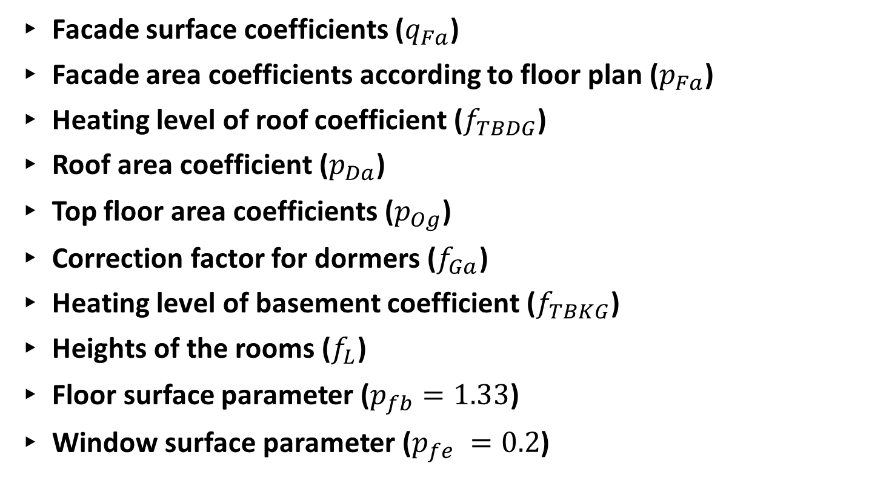
4. 1. Setting the parameters
Facade surface coefficients ($q_{Fa}$)
Facade area coefficients according to floor plan ($p_{Fa}$)
Heating level of roof coefficient ($f_{TBDG}$)
Roof area coefficient ($p_{Da}$)
Top floor area coefficients ($p_{Og}$)
Correction factor for dormers ($f_{Ga}$)
Heating level of basement coefficient ($f_{TBKG}$)
Heights of the rooms ($f_{L}$)
Floor surface parameter ($p_{fb}=1.33$)
Window surface parameter ($p_{fe} =0.2$)

Slide 21
4. 2. Selection of U values
Updated U-value in case of KfW Funding
A) Set Insulation levels for Roof, External walls, Top floor, and Basement
B) Import ORIGINAL U-VALUES from Parameters (based on year of construction)
C) Assumption on subsequent insulation
D) Guidelines for federal funding for efficient buildings set min technical requirement
E) Reference building (residential building) in GEG law
F) Credit Institute for Reconstruction (KfW) funding
G) Calculation of Roof/Exterior Wall/Top Floor/Basement U-values
H) Import U-values and G-values for windows

Slide 22
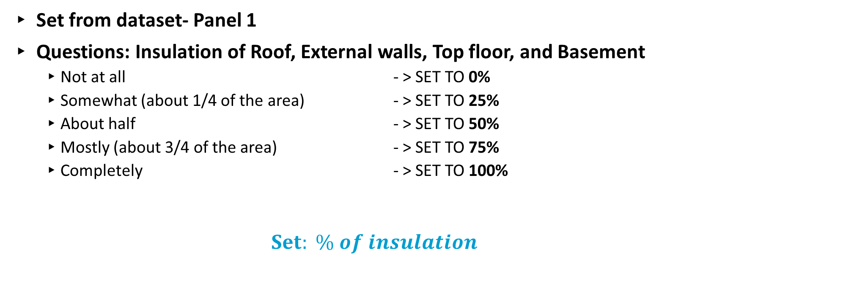
4. 2. Selection of U values
A) Set Insulation levels for Roof, External walls, Top floor, and Basement
Set from dataset- Panel 1
Questions: Insulation of Roof, External walls, Top floor, and Basement
  Not at all - > SET TO 0%
  Somewhat (about 1/4 of the area) - > SET TO 25%
  About half - > SET TO 50%
  Mostly (about 3/4 of the area) - > SET TO 75%
  Completely - > SET TO 100%
  $Set: \% of insulation$

Slide 23
4. 2. Selection of U values
B) Import ORIGINAL U-VALUES from Parameters (based on year of construction)
U_o – Original U values from IWU folder based on year of construction for:
  Roof
  External Walls
  Top floor
  Basement

Slide 24

4. 2. Selection of U values
C) Assumption on subsequent insulation
Fixed value is set for the insulation thickness of Roof, External walls, Top floor, and Basemen:
20cm
$$U_{S}=\frac{1}{\frac{1}{U_{O}}+\frac{0,2m}{0,04[\frac{W}{mK}]}}$$

Slide 25
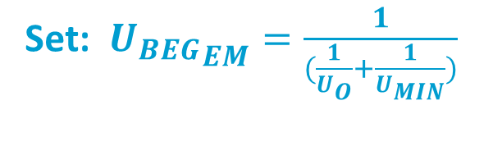
4. 2. Selection of U values
D) Guidelines for federal funding for efficient buildings set min technical requirement
Source: Guideline for federal funding for efficient buildings – individual measures (BEG EM), From 20 May 2021
The following requirements for the thermal transmittance coefficients (U-values) must be met for the respective component in order to receive funding as an individual measure.
Min. technical requirements:
Components | Residential buildings [W/(m²·K)]
Exterior wall | 0.20
Roof | 0.14
Top floor | 0.14
Basement | 0.25
Set: ${U_{BEG}}_{EM}=\frac{1}{(\frac{1}{U_{O}}+\frac{1}{U_{MIN}})}$
Notes:
watts per square meter per degree Kelvin (W/(m²·K))

Slide 26

4. 2. Selection of U values
E) Reference building (residential building) in GEG law
Source: Building Energy Act (GEG), From 8 August 2020
Technical construction of the reference building (residential building):
Components | Heat transfer coefficient [W/(m²·K)]
Exterior wall | 0.28
Roof | 0.20
Top floor | 0.20
Basement | 0.35
Set: $U_{GEG}$
Notes:
watts per square meter per degree Kelvin (W/(m²·K))

Slide 27
4. 2. Selection of U values
F) KfW funding for insulating Roof, Exterior wall, Upper floor and Basement from dataset
Question: Implementation of modernization measures carried out in the course of a Credit Institute for Reconstruction (KfW) efficiency house refurbishment: {KfW-Efficiency-house 55; 70; 85; 100; 115; single measure}
Single Measure Questions: Newly applied insulation of roof, top floor ceiling, exterior walls, basement with KfW funding: {Y,N}
KfW efficiency houses are commonly used and generally accepted standards for the energetic quality of a building
The specifications for the transmission heat loss in the efficiency house is defined as “x + 15”, where x stands for primary energy requirement of the reference house

Slide 28
4. 2. Selection of U values
F) KfW funding for insulating Roof, Exterior wall, Upper floor and Basement from dataset
KfW Efficiency House | Primary Energy Requirement | Transmission Heat Loss
KfW-55 | 55% | 70%
KfW-70 | 70% | 85%
KfW-85 | 85% | 100%
KfW-100 | 100% | 115%
KfW-115 | 115% | 130%

Slide 29
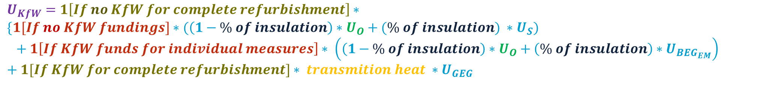
4. 2. Selection of U values
G) Calculation of Roof/Exterior Wall/Top Floor/Basement U-values
$$U_{KfW}=1\left[If no KfW for complete refurbishment\right]∗$$
$$\{1[If no KfW fundings]∗(\left(1−\% of insulation\right)∗U_{O}+(\% of insulation) ∗U_{S})$$
$$+ 1\left[If KfW funds for individual measures\right]∗ \left(\left(1−\% of insulation\right)∗U_{O}+\left(\% of insulation\right)∗U_{BEG_{EM}}\right)$$
$$+ 1[If KfW for complete refurbishment]∗ transmition heat ∗U_{GEG}$$

Slide 30
4. 2. Selection of U values
H) Import U-values and G-values for windows
Based on (ist11) Predominant glazing of windows and (ist10) Year of installation of current windows we can import Parameter data from IWU on U-values and G-Values

Slide 31
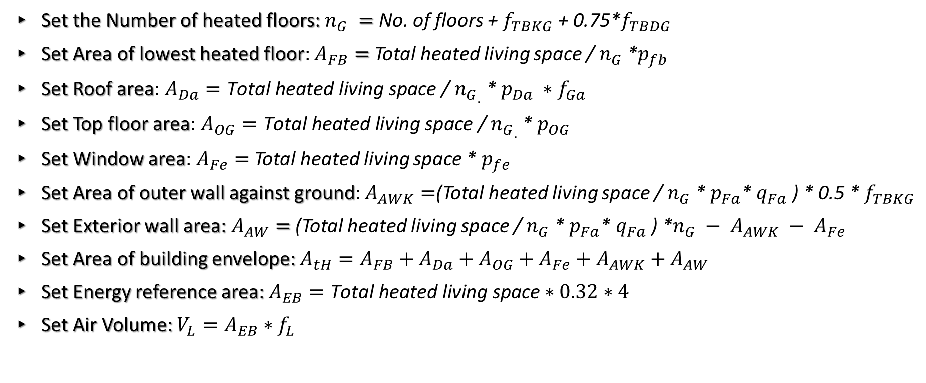
4. 3. Pre - calculations of the building
Set the area of building parts
Set the Number of heated floors: $n_{G} =$No. of floors + $f_{TBKG}$+ 0.75*$f_{TBDG}$
Set Area of lowest heated floor: $A_{FB}=$Total heated living space / $n_{G}$*$p_{fb}$
Set Roof area: ${A_{Da}=\text{Total} \text{heated} \text{living} \text{space}\text{ / }n_{G}}_{.}$* $p_{Da} ∗f_{Ga}$
Set Top floor area: ${A_{OG}=\text{Total} \text{heated} \text{living} \text{space}\text{ / }n_{G}}_{.}$* $p_{OG}$
Set Window area: $A_{Fe}=$Total heated living space * $p_{fe}$
Set Area of outer wall against ground: $A_{AWK}=$(Total heated living space / $n_{G}$* $p_{Fa}$* $q_{Fa}$ ) * 0.5 * $f_{TBKG}$
Set Exterior wall area: $A_{AW}=$(Total heated living space / $n_{G}$* $p_{Fa}$* $q_{Fa}$ ) *$n_{G} − A_{AWK} − A_{Fe}$
Set Area of building envelope: $A_{tH}=A_{FB}+A_{Da}+A_{OG}+A_{Fe}+A_{AWK}+A_{AW}$
Set Energy reference area: $A_{EB}=\text{Total} \text{heated} \text{living} \text{space}∗0.32∗4$
Set Air Volume: $V_{L}=A_{EB}∗f_{L}$
Notes:
Surface floor parameter(p_fb=1.33)
Window surface parameter (p_fe =0.2)
Building envelope - total surface area of all the exterior elements of a building that separate the interior spaces from the outside environment

Slide 32
4. 4. Calculation: Transmission heat loss
Set Parameters for Calculating Transmission Heat Loss
Calculate Transmission Heat Lose for every component of a building:
  Roof
  External Wall
  Top Floor
  Bottom Floor/Basement
  External wall against ground
  Windows
  Thermal bridges losses
Calculate Total Transmission heat loss
Notes:
Thermal bridges are areas where the insulation is not continuous or where there are gaps, resulting in higher thermal conductivity compared to the surrounding insulated areas.

Slide 33

4. 4. Calculation: Transmission heat loss
Set Parameters for Calculating Transmission Heat Loss
Temperature correction factors:
  Reduction factor for Top floor: $Ft_{OG} = 0.8$
  Reduction factor for External wall against ground: $Ft_{AW} = 0.6$
  Reduction factor for Lowest floor: $Ft_{FB} = 0.6$
U-value thermal bridge allowance (In IWU folder is 0.1):$U_{WBZ} = 0.05$
Notes:
Thermal bridges are areas where the insulation is not continuous or where there are gaps, resulting in higher thermal conductivity compared to the surrounding insulated areas.

Slide 34
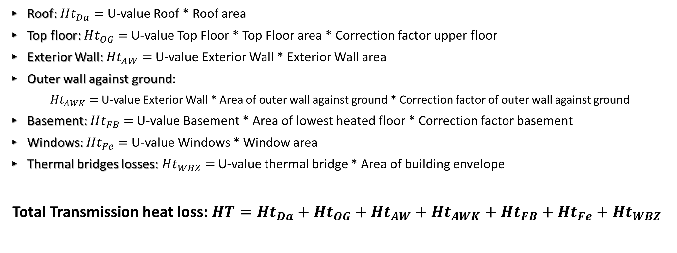
4. 4. Calculation: Transmission heat loss
Calculate Transmission Heat Lose for every component of a building
Roof: $Ht_{Da}=$U-value Roof * Roof area
Top floor: $Ht_{OG}=$U-value Top Floor * Top Floor area * Correction factor upper floor
Exterior Wall: $Ht_{AW}=$U-value Exterior Wall * Exterior Wall area
Outer wall against ground:
$Ht_{AWK}=$U-value Exterior Wall * Area of outer wall against ground * Correction factor of outer wall against ground
Basement: $Ht_{FB}=$U-value Basement * Area of lowest heated floor * Correction factor basement
Windows: $Ht_{Fe}=$U-value Windows * Window area
Thermal bridges losses: $Ht_{WBZ}=$U-value thermal bridge * Area of building envelope
Total Transmission heat loss: $HT=Ht_{Da}+Ht_{OG}+Ht_{AW}+Ht_{AWK}+Ht_{FB}+Ht_{Fe}+Ht_{WBZ}$
Notes:
Thermal bridges are areas where the insulation is not continuous or where there are gaps, resulting in higher thermal conductivity compared to the surrounding insulated areas.

Slide 35
4. 5. Calculation: Heating demand
1. Set parameters for Heating demand calculation
2. Calculate Ventilation heat loss and Energy-efficient building standard
3. Calculation of Heating demand

Slide 36
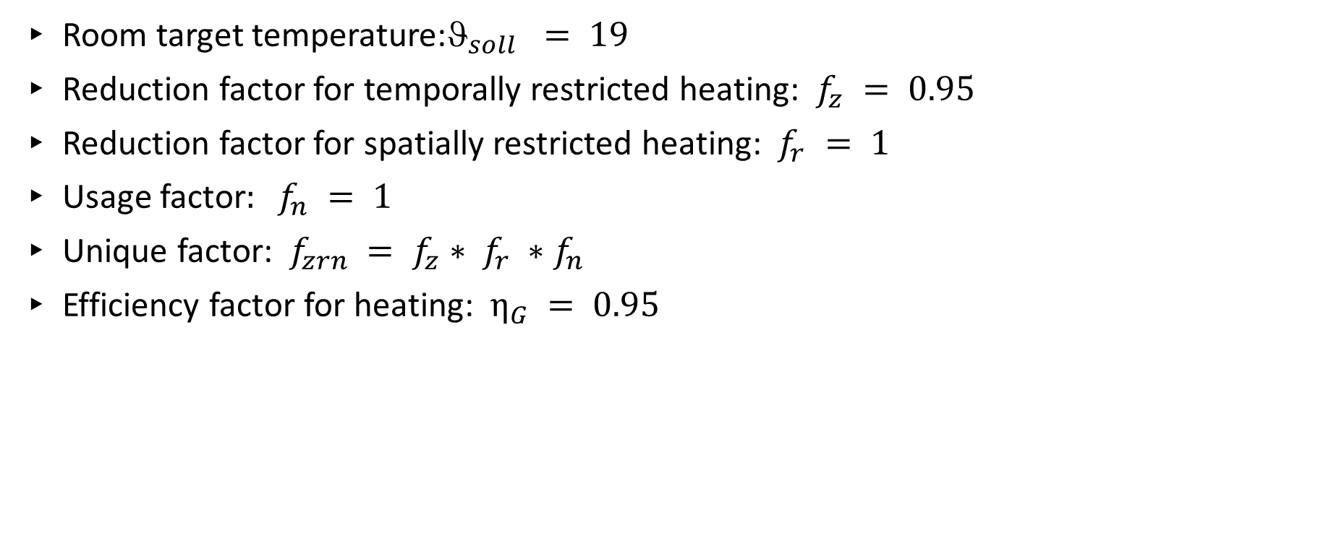
4. 5. Calculation: Heating demand
1. Parameters for Heating demand calculation
Room target temperature:${\text{J}}_{soll} = 19$
Reduction factor for temporally restricted heating: $f_{z} = 0.95$
Reduction factor for spatially restricted heating: $f_{r} = 1$
Usage factor$: f_{n} = 1$
Unique factor: $f_{zrn} = f_{z}∗ f_{r} ∗f_{n}$
Efficiency factor for heating: $η_{G} = 0.95$

Slide 37
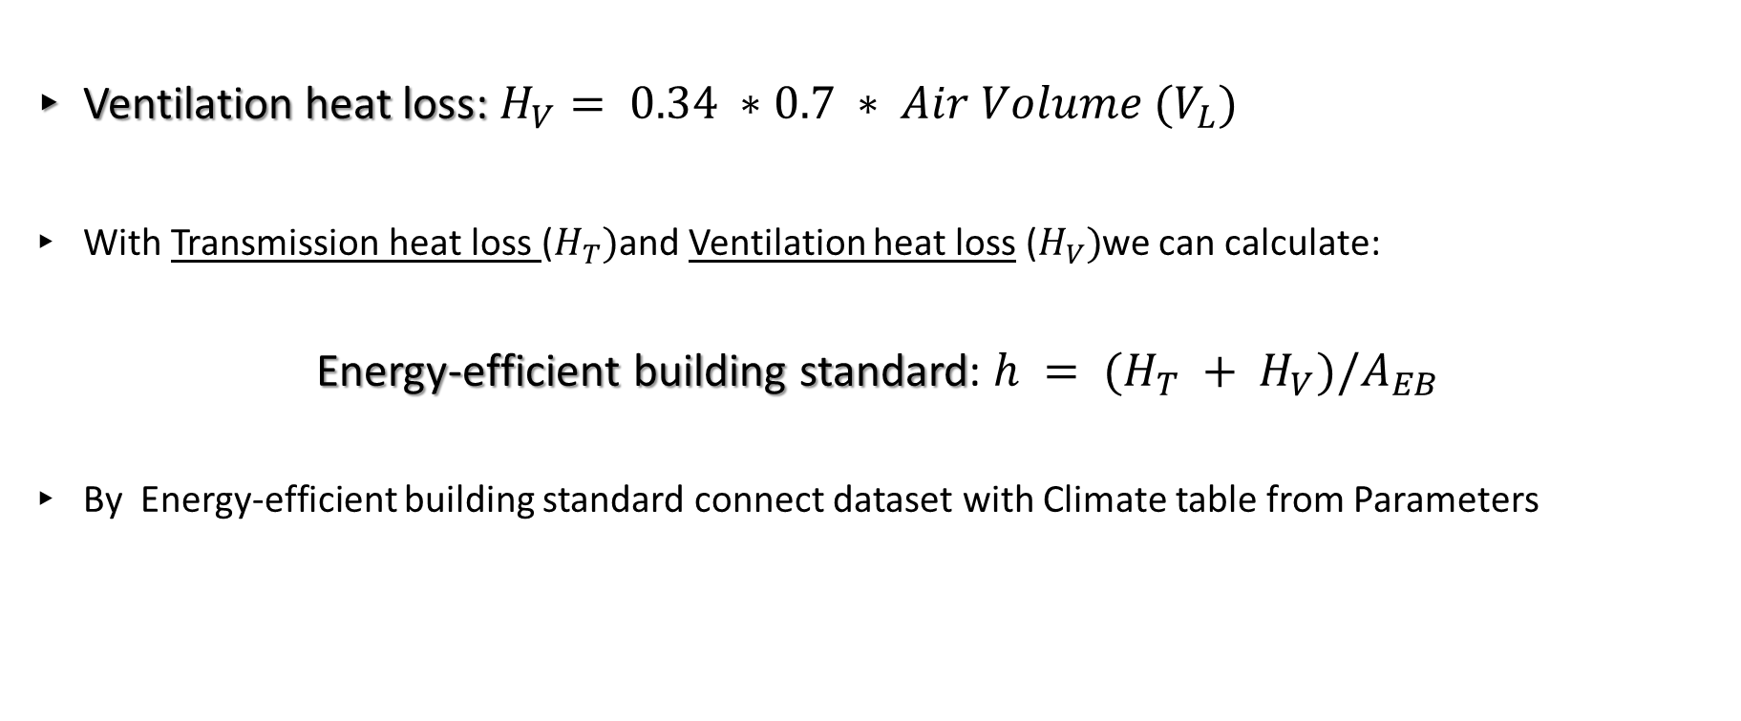
4. 5. Calculation: Heating demand
2. Calculate Ventilation heat loss and Energy-efficient building standard
Ventilation heat loss: $H_{V}= 0.34 ∗0.7 ∗ Air Volume (V_{L})$
With Transmission heat loss ($H_{T})$and Ventilation heat loss ($H_{V})$we can calculate:
  Energy-efficient building standard: $h = (H_{T} + H_{V})/A_{EB}$
By Energy-efficient building standard connect dataset with Climate table from Parameters
Notes:
Energy reference area: $A_{EB}$

Slide 38
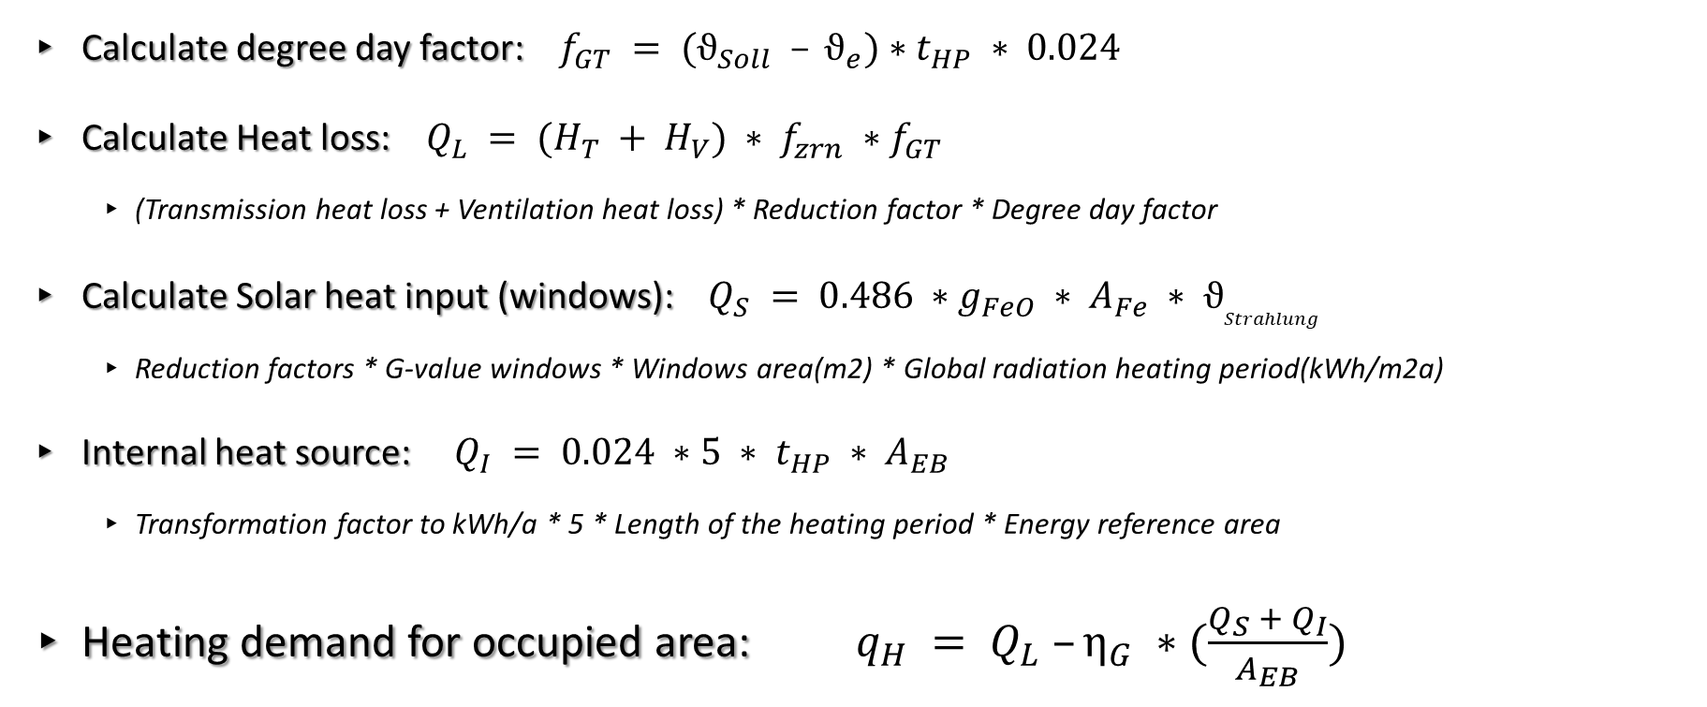
4. 5. Calculation: Heating demand
3. Calculation of Heating demand
Calculate degree day factor: $f_{GT} = (ϑ_{Soll} – ϑ_{e})∗t_{HP} ∗ 0.024$
Calculate Heat loss: $Q_{L} = (H_{T} + H_{V}) ∗ f_{zrn} ∗f_{GT}$
  (Transmission heat loss + Ventilation heat loss) * Reduction factor * Degree day factor
Calculate Solar heat input (windows): $Q_{S} = 0.486 ∗g_{FeO} ∗ A_{Fe} ∗ ϑ_{Strahlung}$
  Reduction factors * G-value windows * Windows area(m2) * Global radiation heating period(kWh/m2a)
Internal heat source: $Q_{I} = 0.024 ∗5 ∗ t_{HP} ∗ A_{EB}$
  Transformation factor to kWh/a * 5 * Length of the heating period * Energy reference area
Heating demand for occupied area: $q_{H} = Q_{L} –η_{G} ∗(\frac{Q_{S} + Q_{I}}{A_{EB}})$
Notes:
Energy reference area: $A_{EB}$

Slide 39
5. Final energy demand calculation
Calculation based on heating parameters
1. Hot water parameter
2. Heating parameter
3. Final energy demand calculation
4. Cost calculation

Slide 40
5. Final energy demand calculation
1. Hot water parameter
Define No. of heated floors and No. of residential units for hot water production
And with defined defined technology used by HH from script 3
Get data from Parameters table:
  Hot water distribution: Heat loss & Auxiliary energy requirement
  Hot water storage: Heat loss & Auxiliary energy requirement
  Hot water generation: Producer effort figure & Auxiliary energy requirement

Slide 41
5. Final energy demand calculation
2. Heating parameter
Define No. of heated floors and No. of residential units for room heating
And with defined defined technology used by HH from script 3
Get data from Parameters table:
  Hot water distribution: Heating credit
  Hot water storage: Heating credit
  Heating transfer: Heat loss & Auxiliary energy requirement
  Heat distribution: Heat loss & Auxiliary energy requirement
  Heat storage: Heat loss & Auxiliary energy requirement
  Heat generation: Producer effort figure & Auxiliary energy requirement
  Climate coefficients: Correction factor for heating period

Slide 42
5. Final energy demand calculation
3. Final energy demand calculation
A) Final energy demand calculation for hot water
B) Final energy demand calculation for heating
C) Final energy demand

Slide 43

5. Final energy demand calculation
3. Final energy demand calculation - A) Final energy demand calculation for hot water
Total heat demand for hot water:
$$q_{w}^{∗} = 12.5+ Heat loss distribution + Heat loss storage$$
Final energy demand for hot water generator 1/2 without auxiliary energy demand:
$$q_{ew1/2} = q_{w}^{∗} ∗ (Hot water generation: Producer effort figure 1/2 ∗α_{wg1/2})$$
Final energy demand for hot water auxiliary energy:
$$q_{hew} = Hot water distribution: Auxiliary energy requirement + Hot water storage: Auxiliary energy requirement + (Hot water generation: Auxiliary energy requirement 1 ∗ α_{wg1})+(Hot water generation: Auxiliary energy requirement 2 ∗ α_{wg2})$$
Final energy demand for hot water: $q_{ww} = q_{ew1} + q_{ew2} + q_{hew}$
Notes:
Utilisation rate of heat supply q_W =12.5
Alpha_wg1 = 0.6 if you use central solar thermal system used for warm water otherwise 1
Alpha_wg2 = 1- Alpha_wg1

Slide 44
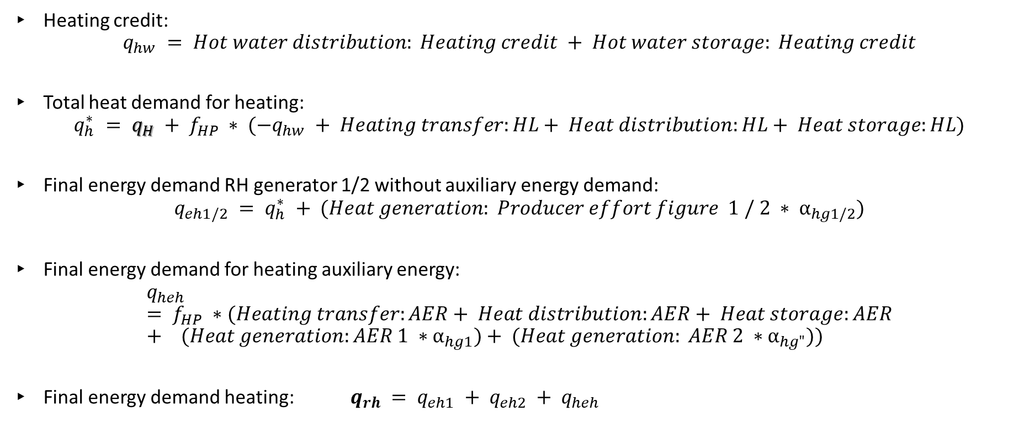
5. Final energy demand calculation
3. Final energy demand calculation - B) Final energy demand calculation for heating
Heating credit:
$$q_{hw} = Hot water distribution: Heating credit + Hot water storage: Heating credit$$
Total heat demand for heating:
$$q_{h}^{∗} = q_{H} + f_{HP} ∗ (−q_{hw} + Heating transfer:HL+ Heat distribution:HL+ Heat storage:HL)$$
Final energy demand RH generator 1/2 without auxiliary energy demand:
$$q_{eh1/2} = q_{h}^{∗} + (Heat generation: Producer effort figure 1 / 2 ∗ α_{hg1/2})$$
Final energy demand for heating auxiliary energy:
$$q_{heh} = f_{HP} ∗(Heating transfer:AER+ Heat distribution:AER+ Heat storage:AER+ (Heat generation:AER 1 ∗α_{hg1})+ (Heat generation: AER 2 ∗α_{hg"}))$$
Final energy demand heating: $q_{rh} = q_{eh1} + q_{eh2} + q_{heh}$
Notes:
Alpha_hg1 = 0.8 if Type of heat generation of heat pump is Heat pump with boiler/heater otherwise 1
Alpha_hg2 = 1- Alpha_hg1

Slide 45

5. Final energy demand calculation
3. Final energy demand calculation - C) Final energy demand
Final energy demand calculation$:$
  $$EBJ = q_{ww} + q_{rh}$$

Slide 46

5. Final energy demand calculation
4. Cost calculation
Import cost data from Parameters table on hot water and heating prices
Calculation of total cost of hot water:
$$k_{ww} = p_{wwet1} ∗q_{ew1}∗ heating space ∗1.28/100$$
Calculation of total cost of heating:
$$k_{rh} = p_{rhet1} ∗q_{eh1}∗ heating space ∗1.28/100$$
Absolute costs (EUR)/year: $KDJ = k_{ww} + k_{rh}$
Notes:
P_wwet – is price for hot water generator

Slide 47
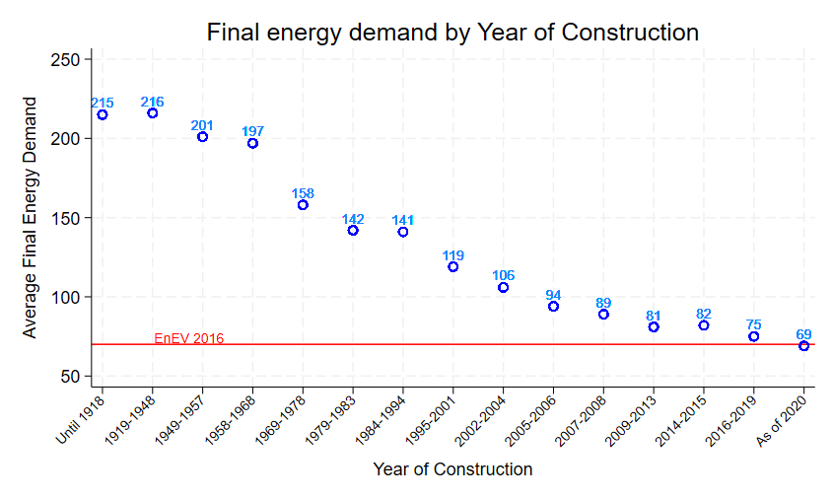

Slide 48
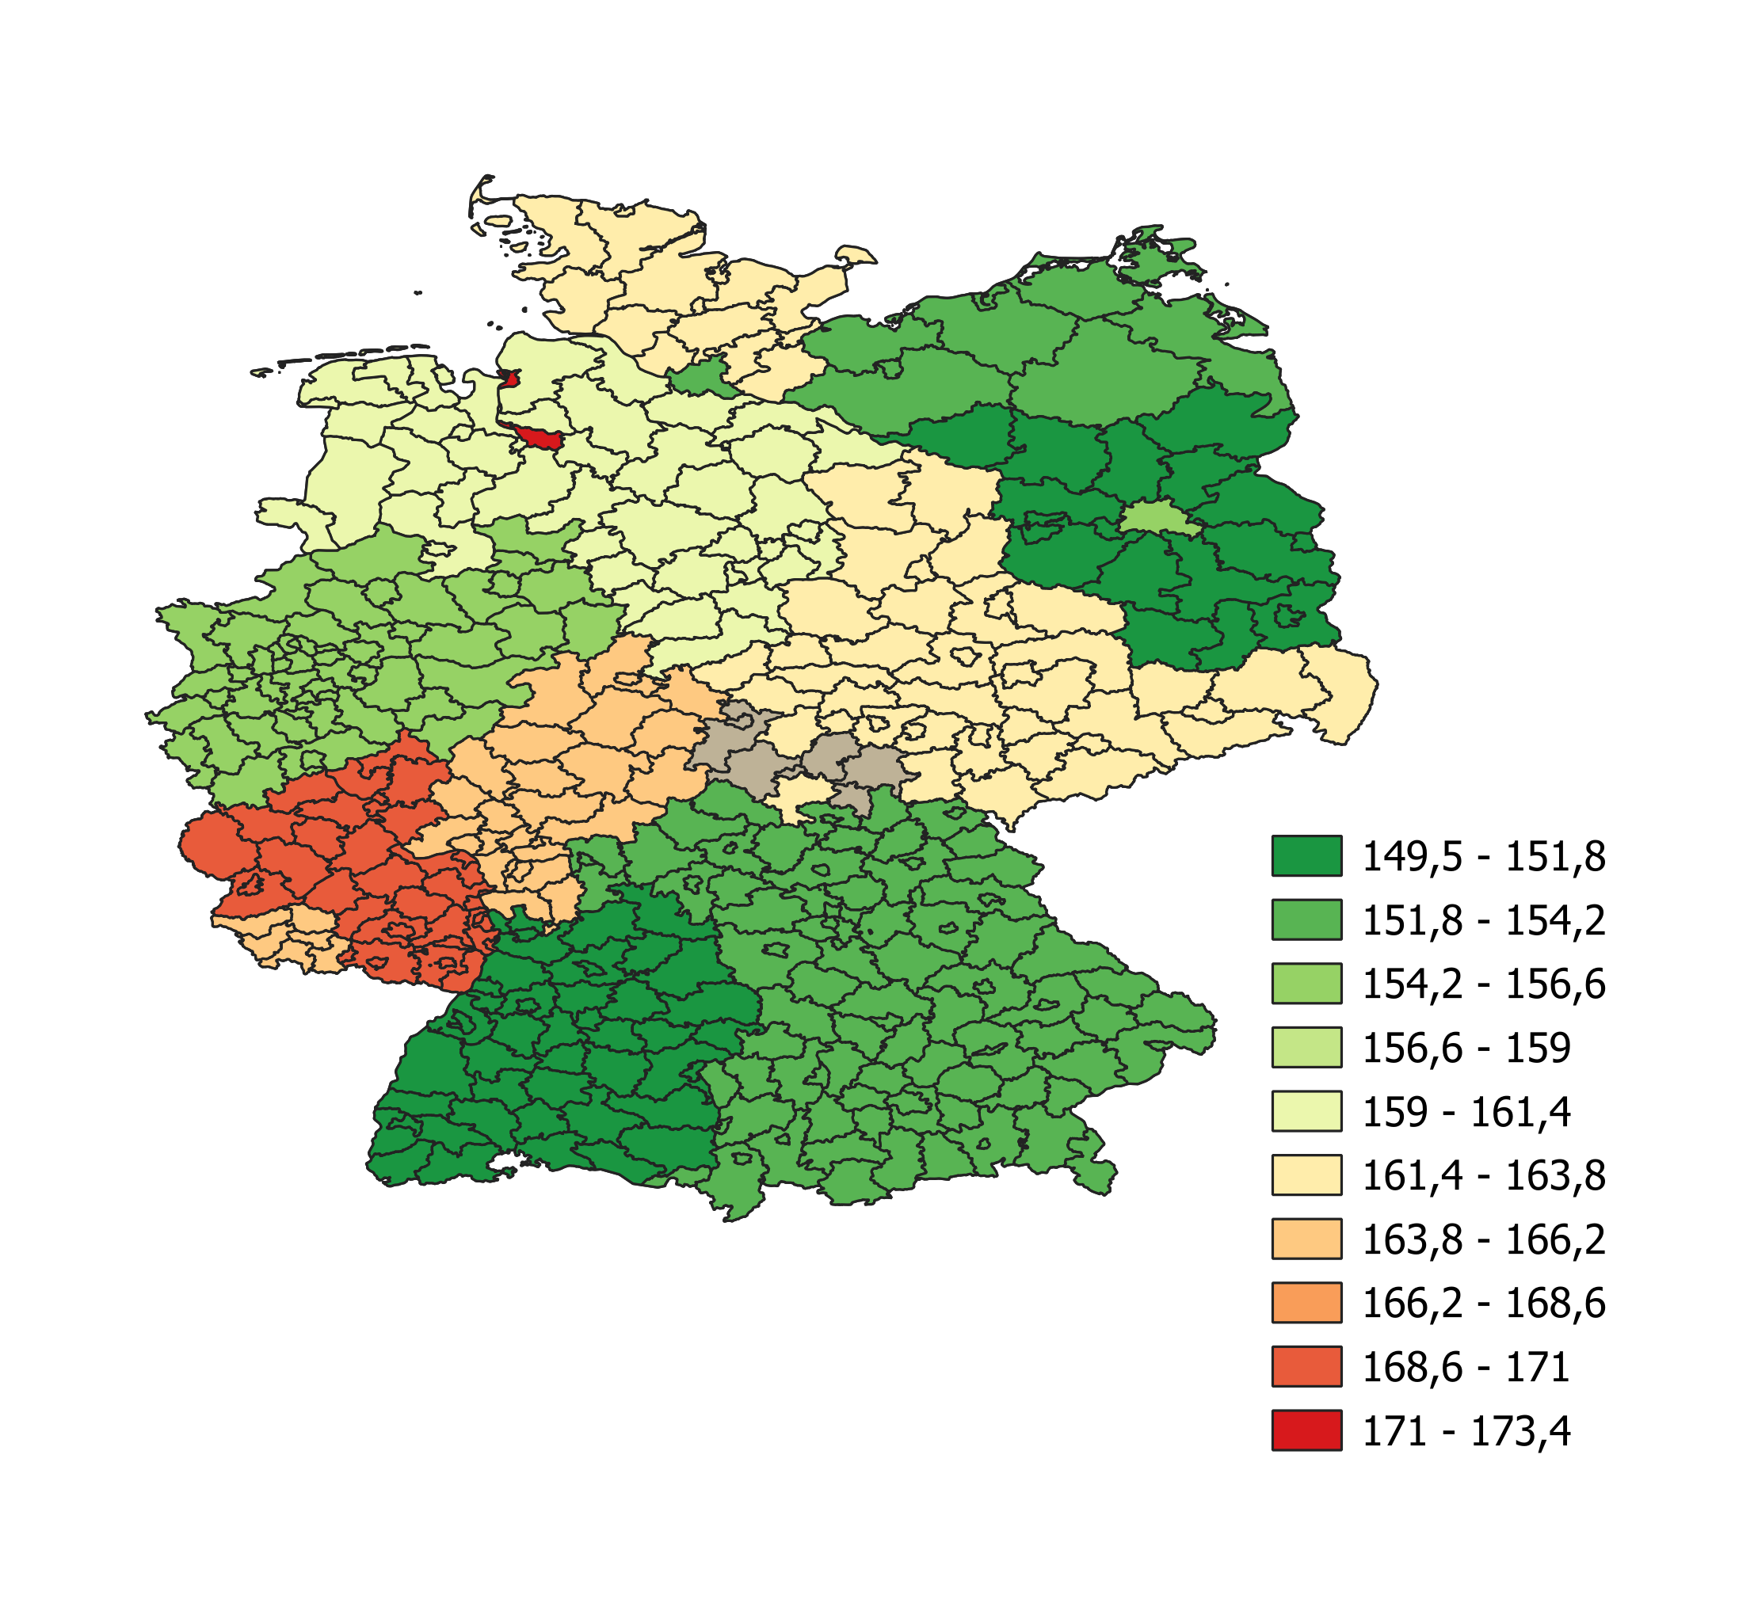
Weighted average Final energy demand across Germany states

Slide 49

Thank you!
RWI
Martin Milcetic

